Slide 1

Sagar Institute of Science & Technology (SISTec)
(Department of Computer Science & Engineering)
Design and Development of Online Examination System
Pankaj Lal (0187CS171098)
Khushboo Patel (0187CS171073)
Under the guidance of
Prof. Ruchi Jain

Slide 2
What is Online Examination System?
A generalize platform for conducting online exams for the students with multiple different features to provide an equal and fair opportunity with an anti-cheat feature so that every student gets a fair chance. This web-app has features like creating tests, proctoring, evaluation of tests.

Slide 3
Why we need OES?
We want to provide an institution level best online conducting test system. So instead of using third party resources we can provide our own. We are making this system anti-cheat as much as possible.

Slide 4
How the system works?

Slide 5
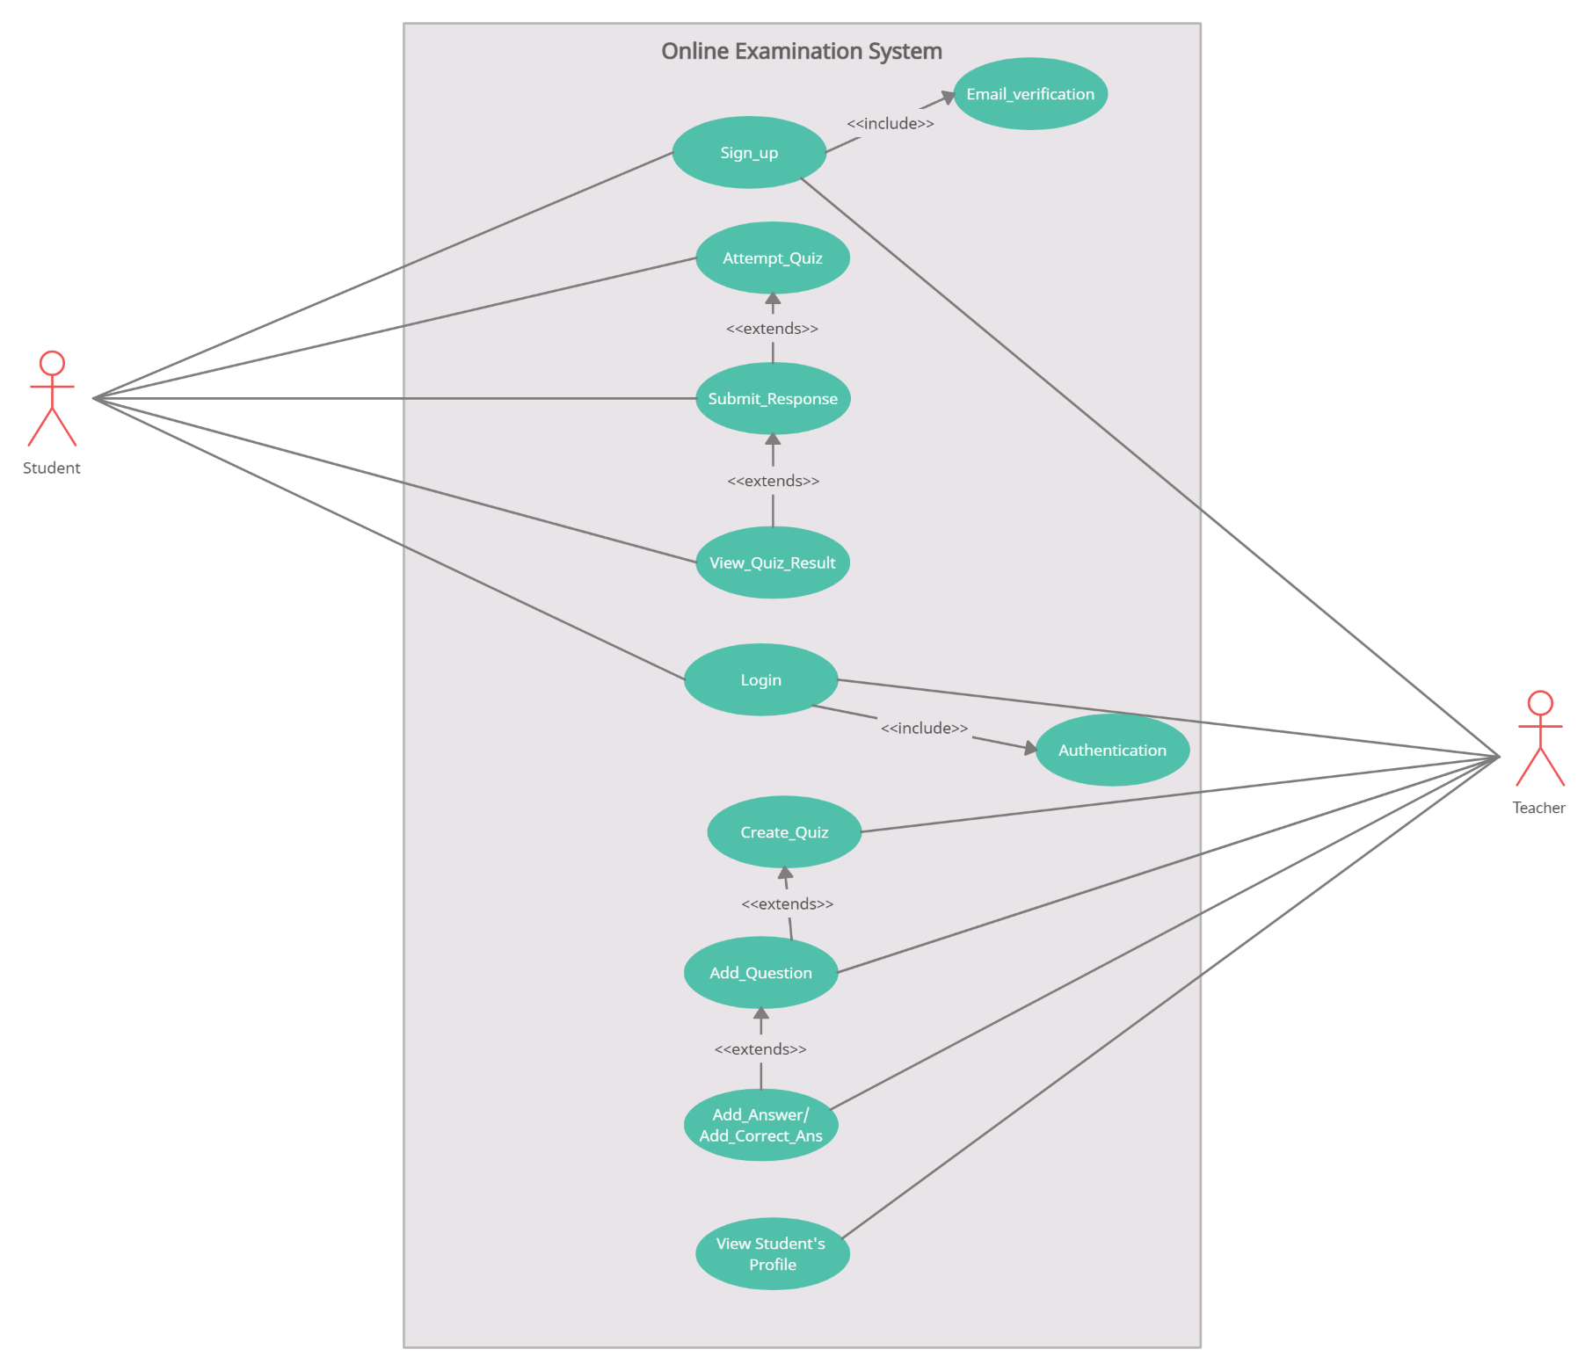

Slide 6
Integration and front end of the system
Django framework is used to build the system. Where for adding features in the web page like timer we have used javascript along with HTML and CSS.
Python language was used to built the system where the approach was Functional oriented.
For the database we used SQLite3.

Slide 7
Algorithm Used
To make the system anti cheat we applied an algorithm of machine learning. The algorithm detects the face and keeps the track of rapid eyeballs movement using webcam.
For real time gaze tracking we used Dlib and OpenCV
Dlib is used for detecting facial keypoint and OpenCV for further image processing.

Slide 8
Dlib
For this will use a pre-trained network in the dlib library which can detect ’68 key points’
The facial key point detector takes a rectangular object of the dlib module as input which is simply the coordinates of a face. To find faces we can use the inbuilt frontal face detector of dlib.

Slide 9
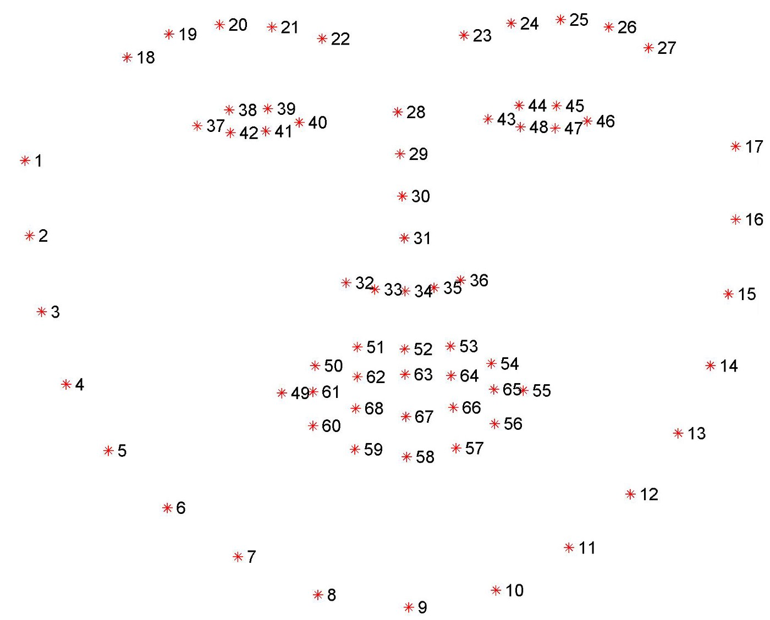

Slide 10
OpenCV
To open the webcam, read frames, and display it we used cv2 module.
We create a new black mask using NumPy of the same dimensions as our webcam frame. Store the (x, y) coordinates of the points of the left and right eyes from the keypoint array shape and draw them on the mask.
After segmenting eyes on mask we can find contours.

Slide 11
Future Scope
Applying Algorithm using javascript so server load can be reduced.
Detecting other devices.
Applying more method to make anti cheat platform.
Providing more features to the platform.

Slide 12


